Slide 1
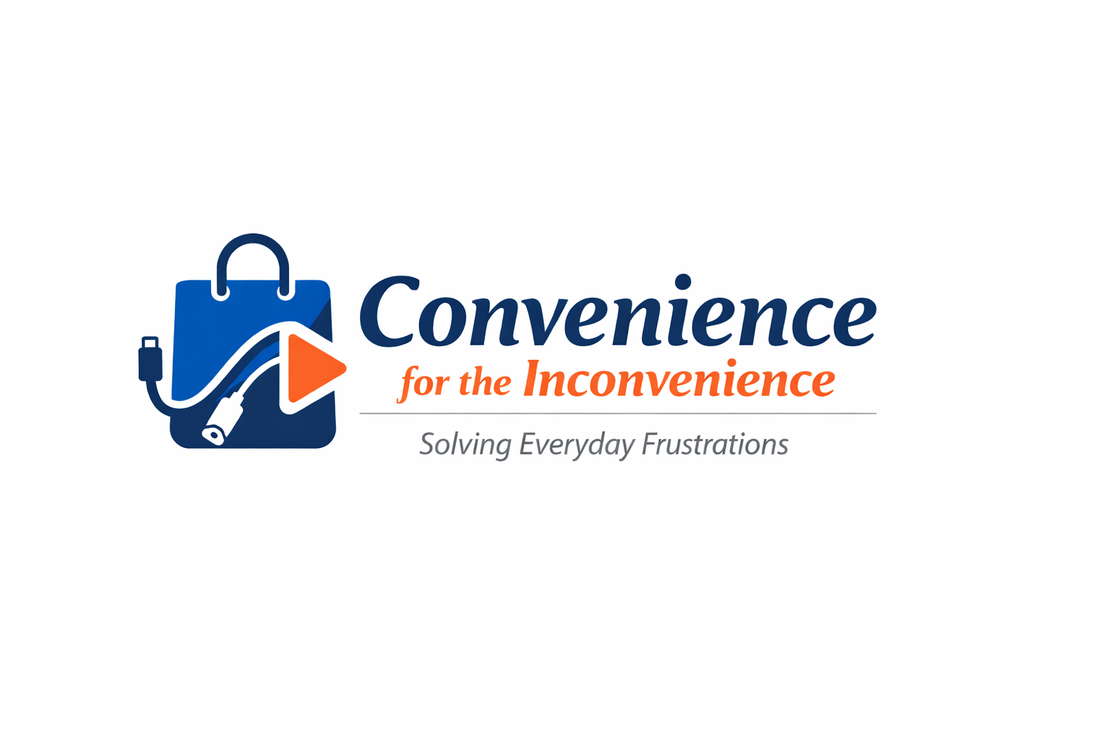
Convenience for the Inconvenience Solving the small problems that make life harder than it needs to be
By: Shannon Cullen, Ryan Jankowski, Rohan Pratap Reddy Ravula, Annanahmed Shaikh, and Sarah Stantial
Date: February 9, 2026 Prof. Val Galitskiy

Slide 2
Our Mission
Every day, we encounter tiny frustrations that slow us down, cost us money, or just make things more complicated than they should be. Most people accept these as part of life. We don't.
Our team is focused on identifying these overlooked inconveniences—the recurring pain points that people have learned to live with—and developing practical solutions that genuinely improve daily life.
From juggling too many shopping bags to hunting for the right charging cable to paying for multiple streaming services just to watch a couple shows—these are the problems worth solving.
Notes:
Annan

Slide 3
Pain Point 1: The Burden of the Bag: Solving the Last-Mile Grocery Strain
Affected people
The group of people who are affected by this are : Primary Users (Urban commuters, students, and employees without personal vehicles), Vulnerable Groups (Elderly shoppers and people with disabilities), Caregivers (Parents managing both children and heavy groceries) and Business Stakeholders (Retailers facing capped sales due to consumer carrying limits).
Core problem
Ergonomic Design Failure: Thin plastic/paper handles concentrate high-pressure weight onto small surface areas of the fingers and palms.
Physical Strain: Unbalanced loads over long walking distances cause acute pain in the back, shoulders, and hands.
Structural Instability: Standard retail bags lack the integrity to hold heavy staples (milk, detergents), leading to fear of bag breakage.
Why it matters
Health & Safety: Physical injury (strains) and "purple palm" bruising from restricted circulation.
Economic Loss: Consumers buy fewer items per trip because they cannot physically carry more, directly reducing retailer revenue.
Financial Burden: Users are forced to pay expensive "Quick-Commerce" delivery fees just to avoid the physical labor of hauling goods.
Environmental Cost: The "Double-Bagging" habit increases plastic waste unnecessarily to compensate for poor bag strength.
Examples
Market Adaptations: The surge in "hook-style" carriers and "granny carts" proves that standard bags are insufficient.
The 15-Minute Delivery Boom: Rapid growth in grocery apps is fueled by the desire to avoid the "last-mile" physical struggle.
Accessibility: The customers tend to move to retail shops nearby their homes and pay more price for goods instead of going to supermarkets, shopping malls which are far away due to the physical struggle of carrying the bags.
Notes:
Rohan

Slide 4
Pain Point 2: Not Having the Right Cable
Young to old, many people have technology that moves with them
Phones, laptops, tablets are used every day for work and personal
Few different medical devices that require to be recharged
Each object has different charging ports
Frustrations this causes
Delays – needing to find the right cable for the product takes time away from other tasks (work, relaxing, traveling)
Costs – thinking to get back-up chargers and putting them most likely to be used can cost anywhere from 10 to 100 dollars depending on the number of chargers purchased.
Preparation - having to make sure everything is ready to be taken somewhere or it is already placed where it will be needed.
Why it matters
Decreases stress in completing tasks
More time on things that matter
Saving money on purchasing chargers
Examples
Some glucose monitors are linked to a phone that help tell the user of low or high glucose which they can than treat but if the phone is dead, they do not know and could end up having an emergency occur
When trying to complete an assignment that is due that night, but the laptop dies thinking that the charger was packed but end up needing to run to an electronic store to get a new charger.
Notes:
Shannon

Slide 5






Pain Point 3: Too Many Subscriptions
Streaming has become one the most popular forms of media consumption but also one of the most decentralized
Each show and movie is only offered on select streaming platforms, forcing consumers to manage multiple subscriptions
Platforms have also begun to produce their own entertainment available exclusively with them, leaving consumers no other option than to subscribe
Frustrations this causes:
Lack of accessibility – if you don’t have the platform to watch something, you need to purchase a whole new subscription, figure out an alternative (use a friend’s account, pirate, etc.), or simply not watch it
Financial waste – being subscribed to multiple different services to access as little as one thing is a waste of money and lead to financial strain
Why it matters
This frustration is experienced by anyone who uses streaming as a main source of entertainment, which is the vast majority of people
Notes:
Shannon

Slide 6
Pain Points: Industries
Industries Affected
Industries Affecting
The Burden of the Bag
Grocery/food delivery driver: A product to more efficiently carry grocery bags can be used by drivers and carriers
Retail workers: Clothes hangers or different products could be moved around more efficiently.
Not Having the Right Cable
General industry: Company phones compared to personal phones. Different adapters?
IT: IT can use this product as a one of their tools on their tool belt
Too Many Subscriptions
Data industries: Stockbrokers/News agencies/data analysts can access the channels and sources without the hassle or need to sign up and participate in multiple media platforms.
The Burden of the Bag
Grocery/food delivery apps: Making said efficiency product mandatory for drivers.
Not Having the Right Cable
IT: Can push products to solve this problem within companies.
CEO: Purchase and push this product similar to IT
Too Many Subscriptions
News Agency: Can partner with this program to streamline adaptation

Slide 7
Thank you!
Small problems create big friction when they happen every day. Carrying groceries, finding the right charger, and managing subscriptions all waste time, money, and energy for millions of people.
These pain points are real, recurring, and solvable, and addressing them creates meaningful value by improving daily life and relieving frustration.
Solving everyday friction is where practical innovation begins.

